Slide 1
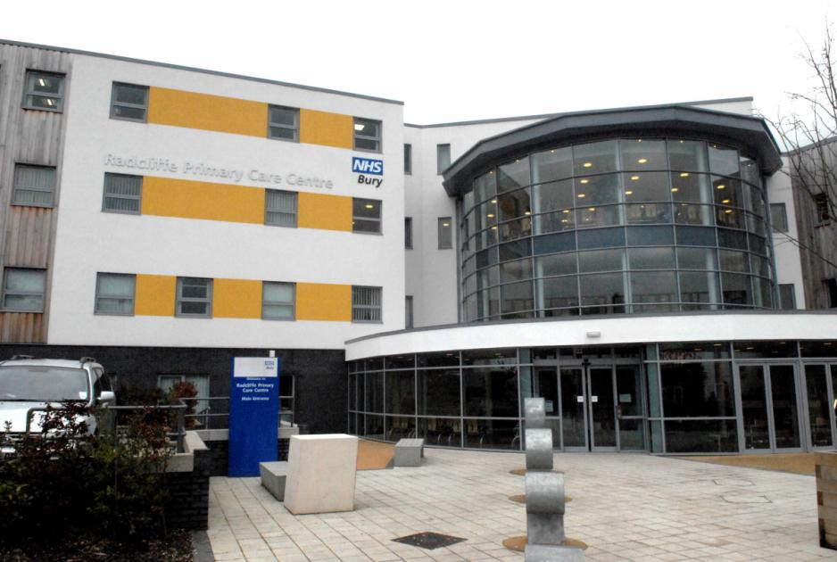
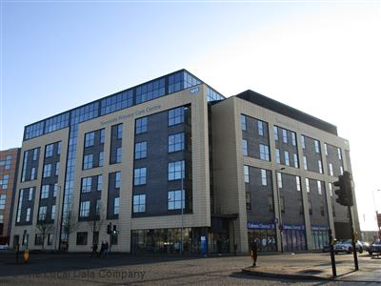
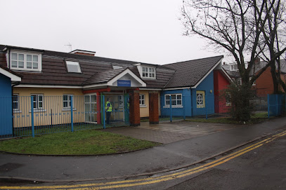
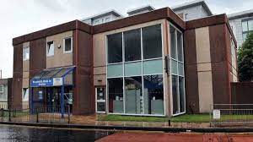
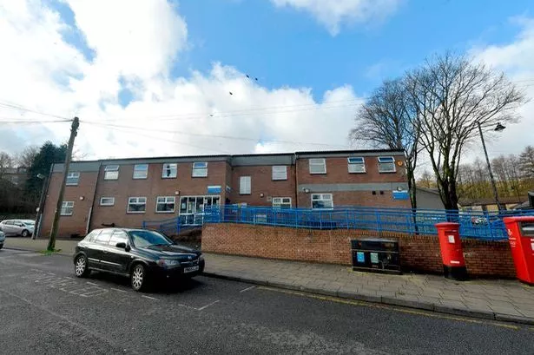
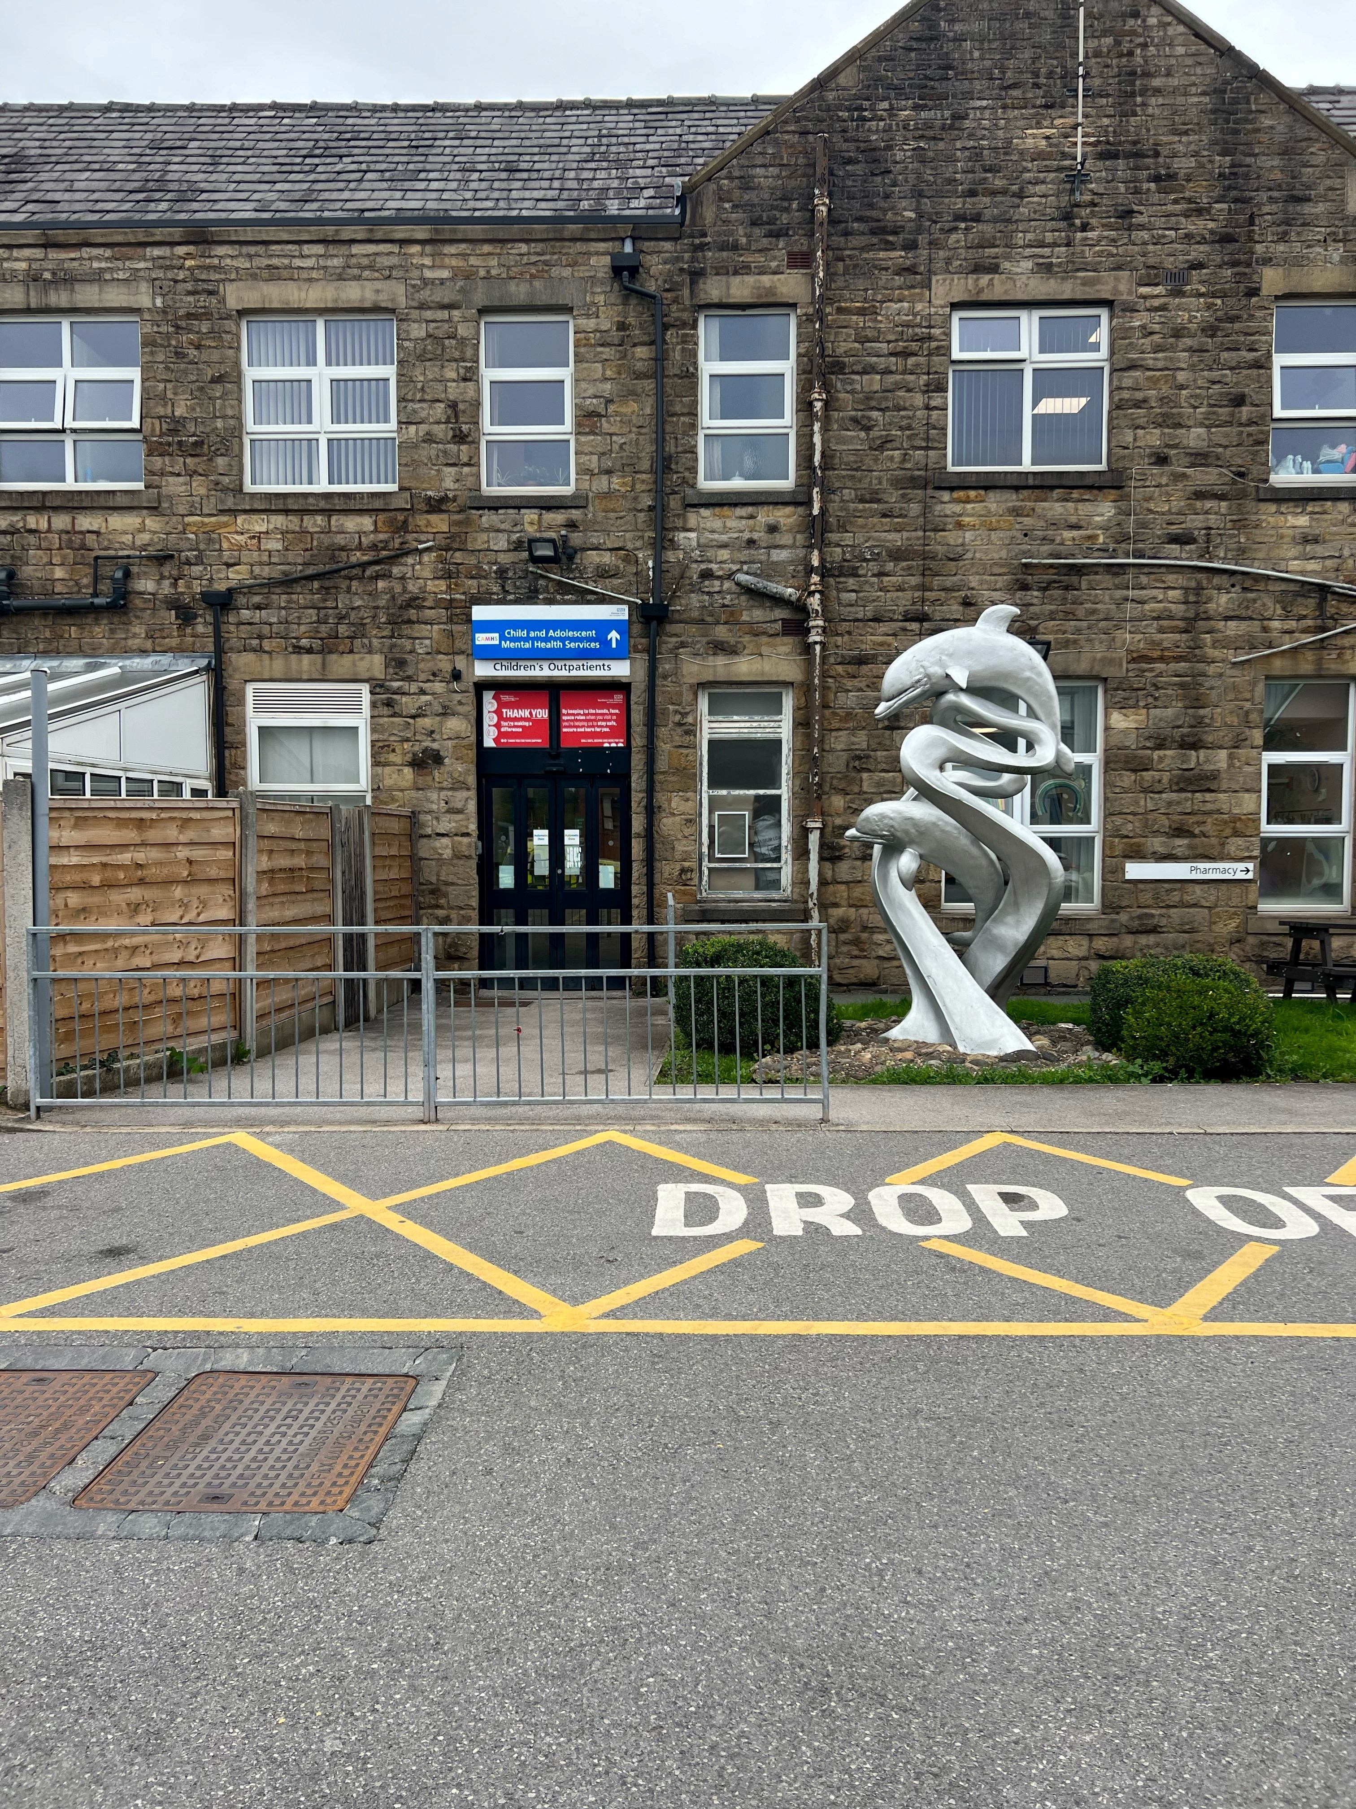
Bury Paediatric Speech and Language Therapy -
Welcome to our clinics

Slide 2
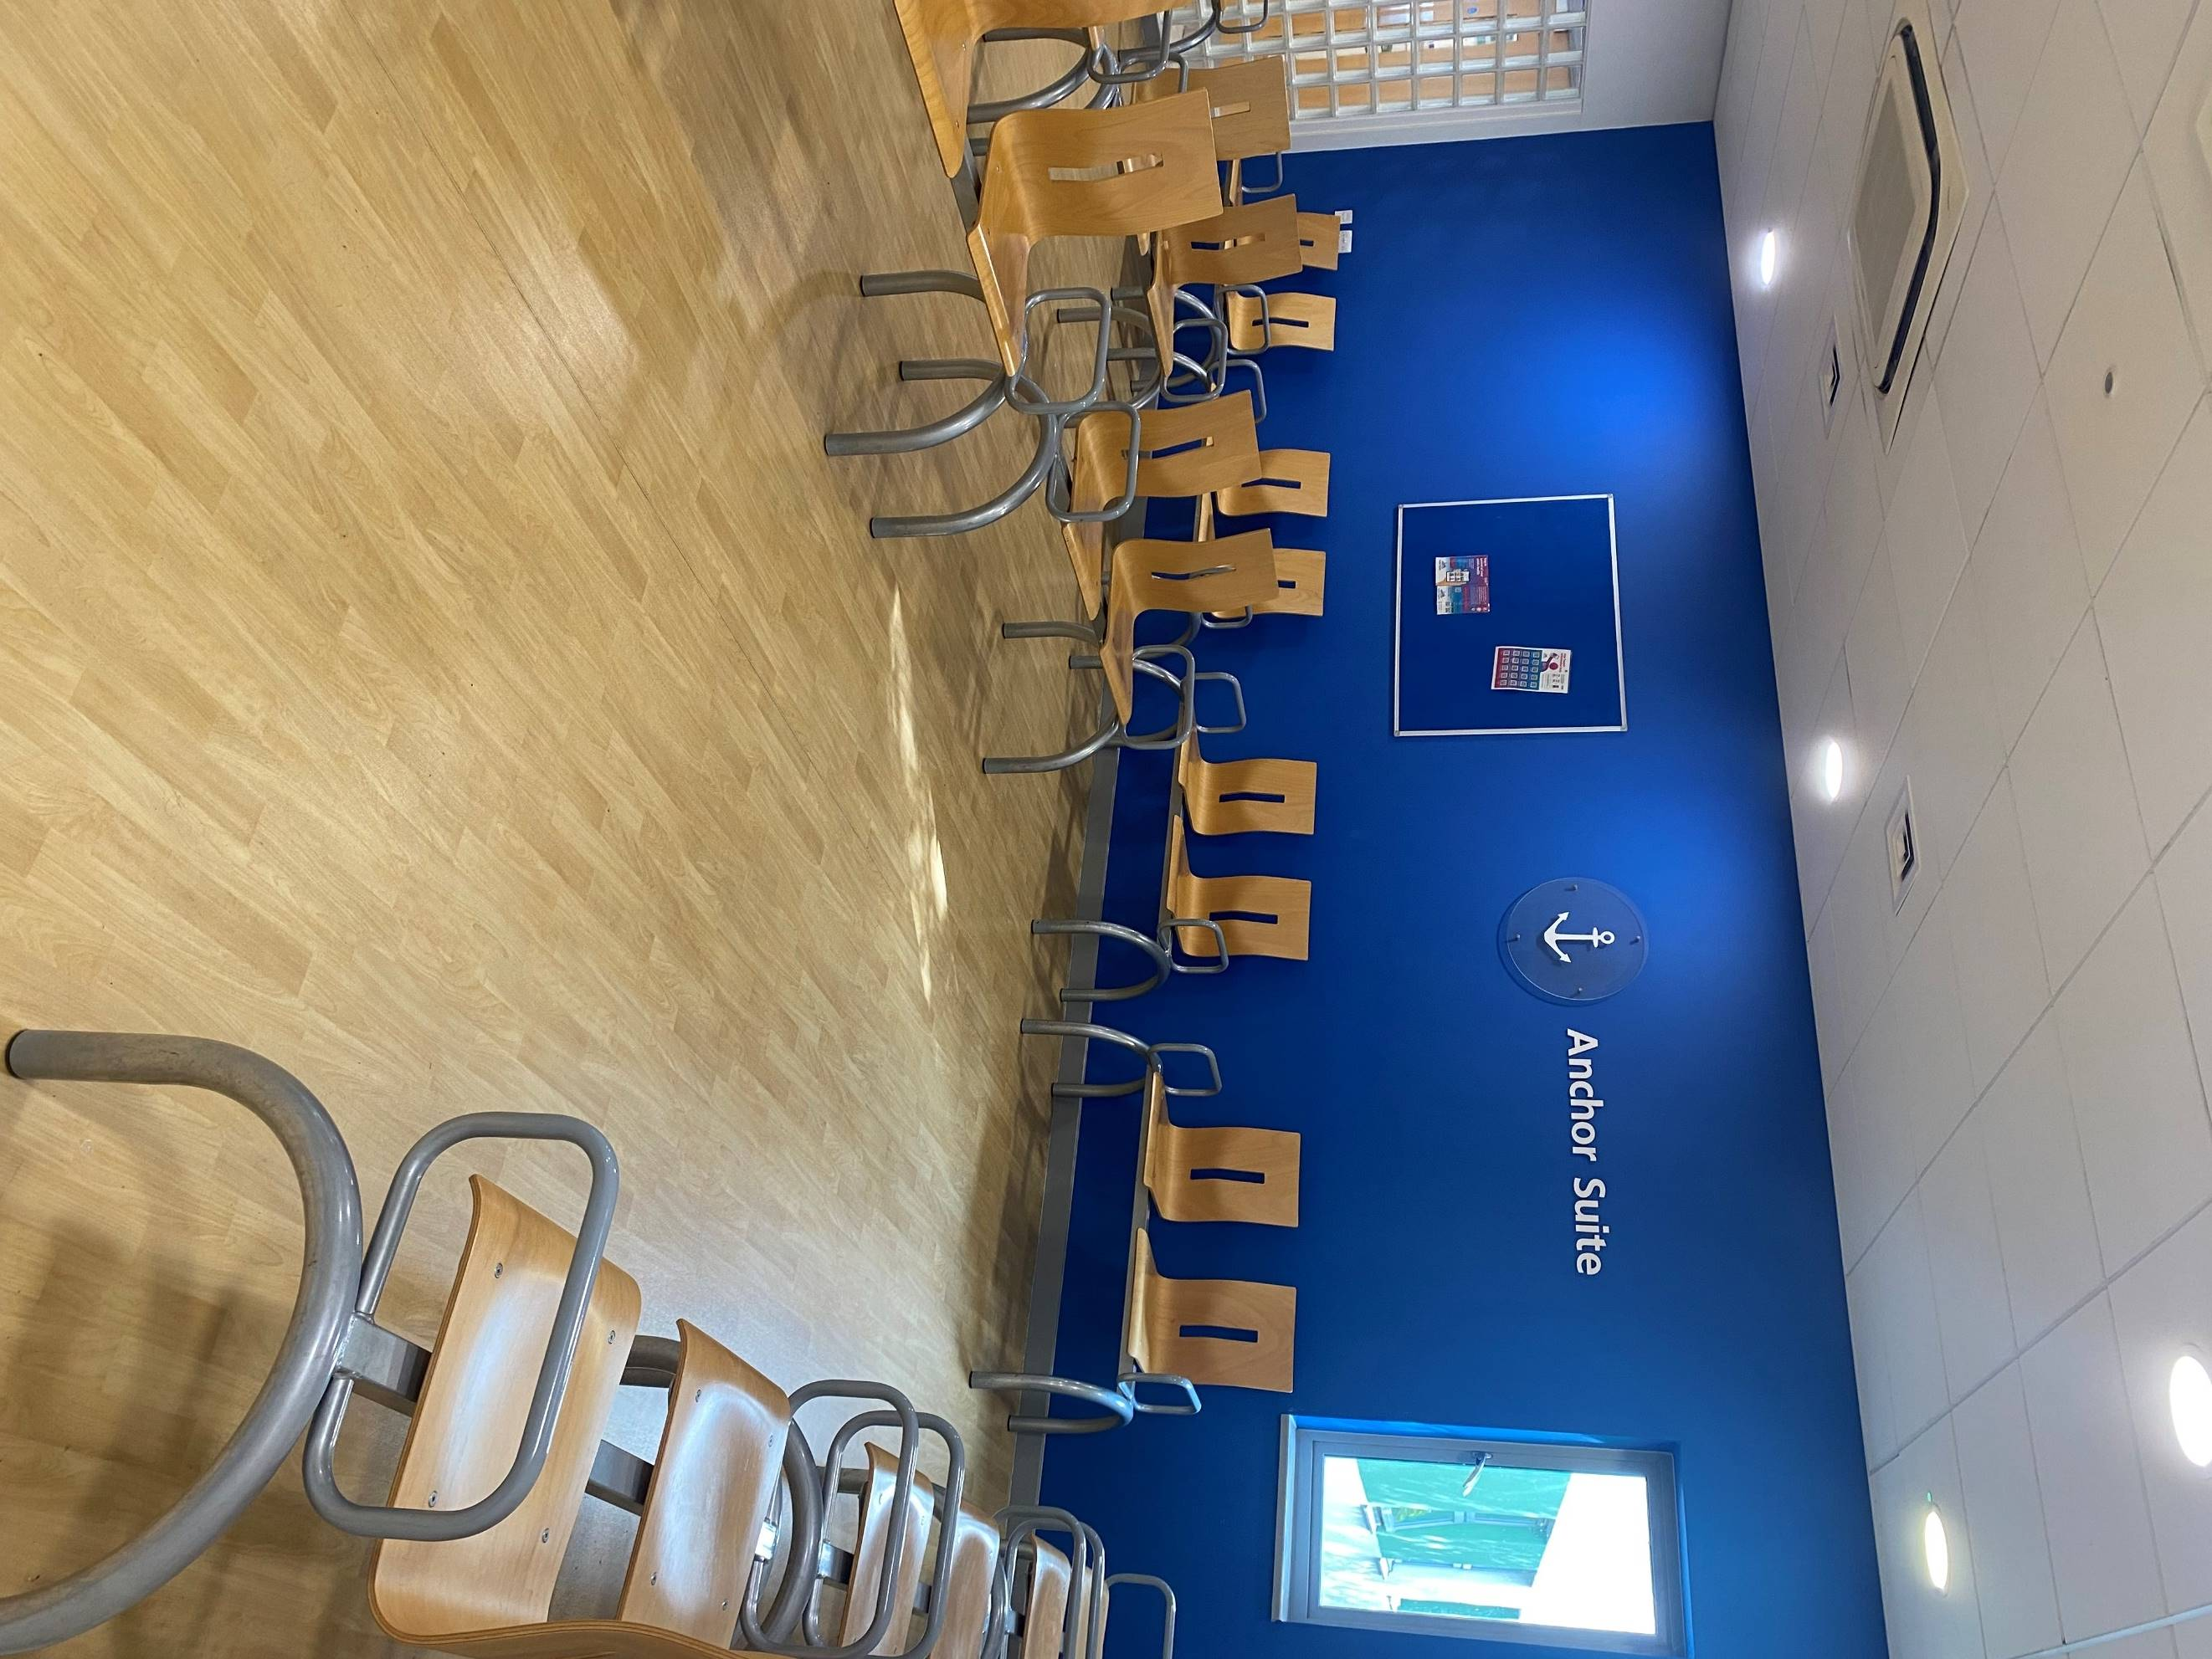
Radcliffe Primary Care Centre (RPCC)
What is the address?
Radcliffe Primary Care Centre, 69 Church Street West, Radcliffe, M26 2SP
Where can I park?
In the free car park to the left of the building
What does the building look like and where do I wait?

Slide 3
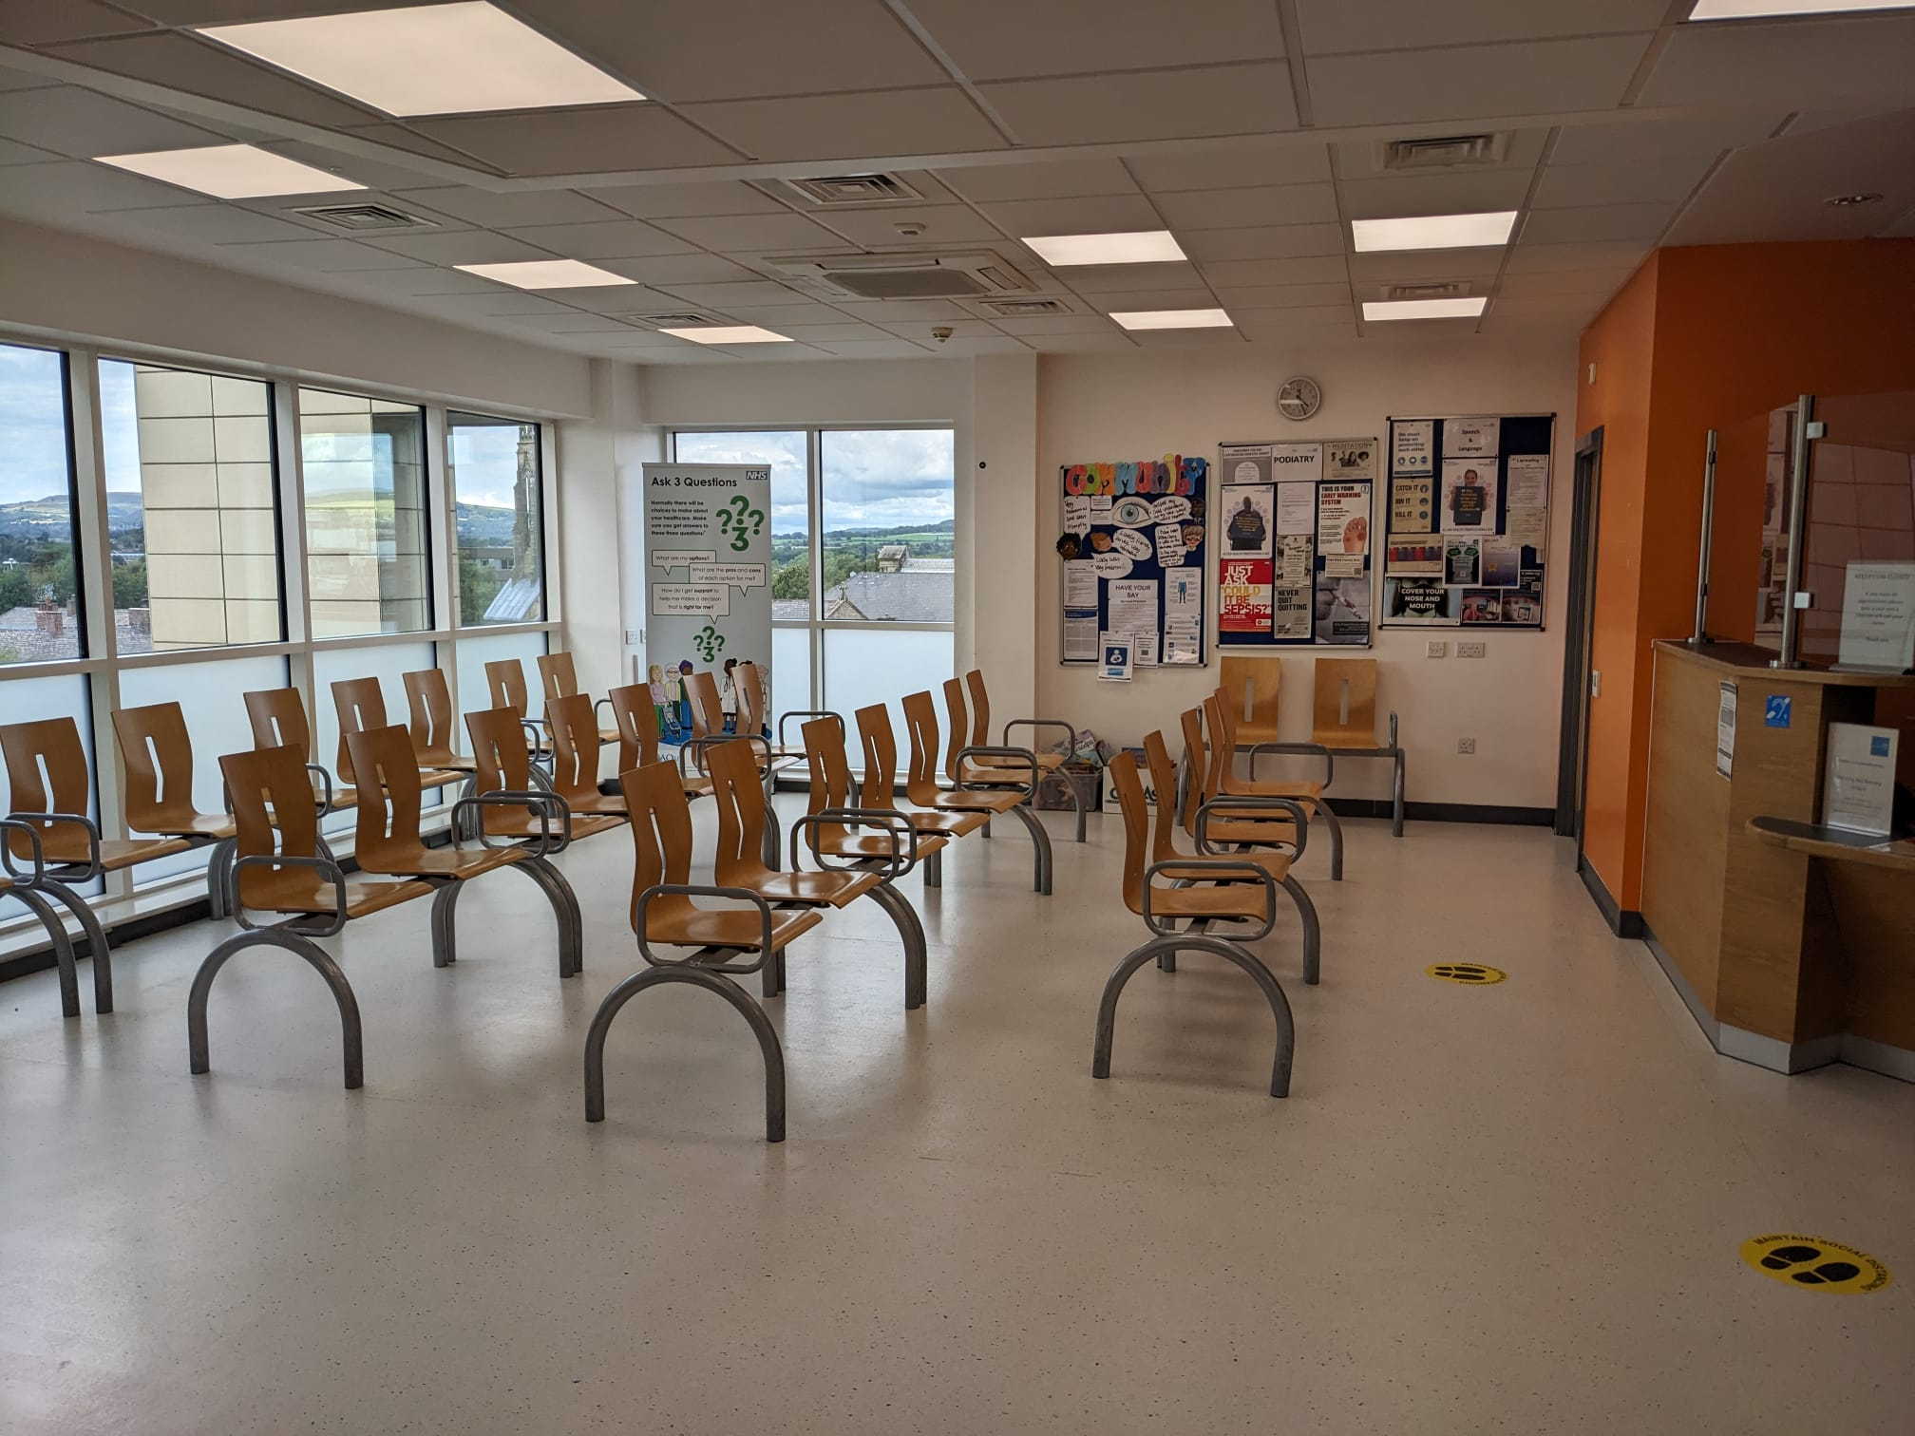
Townside Primary Care Centre (TPCC)
What is the address?
Townside Primary Care Centre, Knowsley Street, Bury, BL9 0SN
Where can I park?
At the Q-Park next to the building or on the street (pay and display)
What does the building look like and where do I wait?

Slide 4
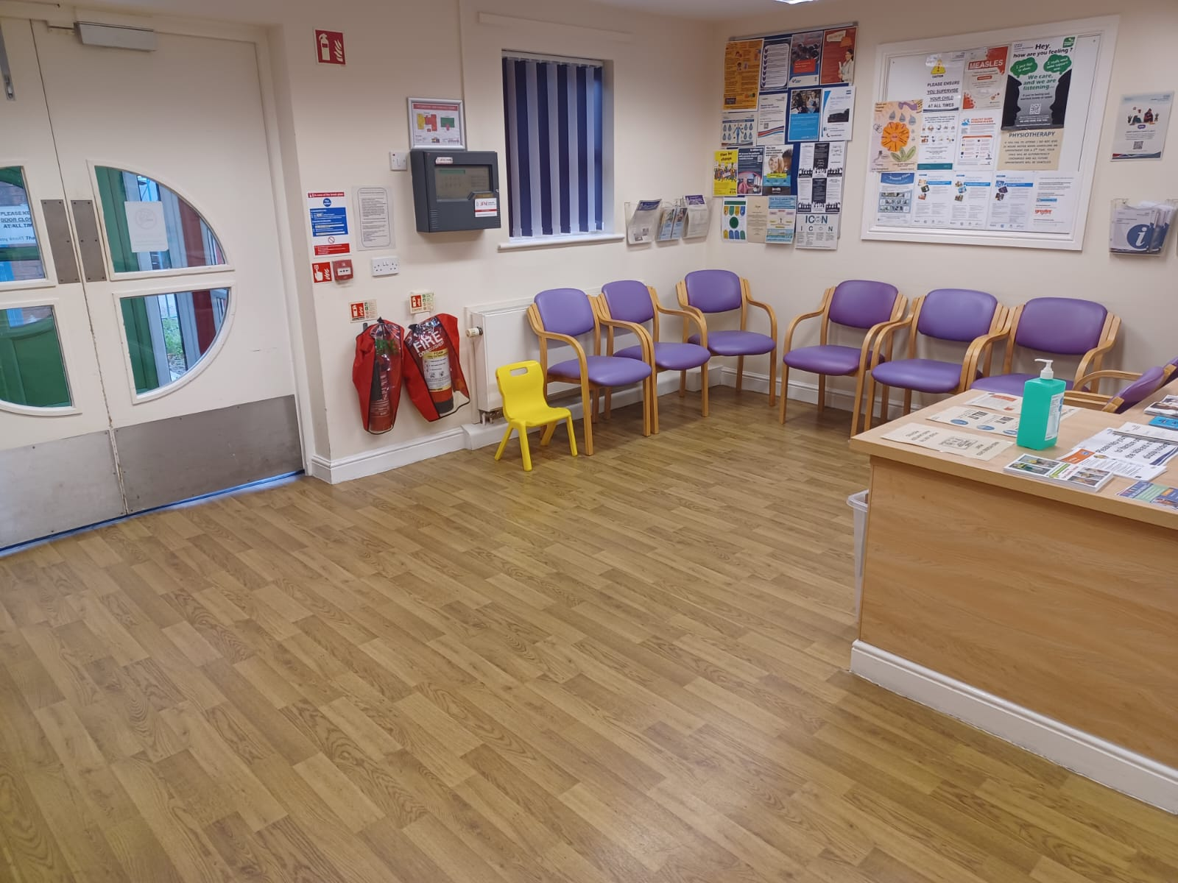
Bury Living Well Centre
(BLWC)
What is the address?
Bury Living Well Centre, Morley Street, Bury, BL9 9JQ
Where can I park?
On the surrounding residential streets (Free)
What does the building look like and where do I wait?

Slide 5
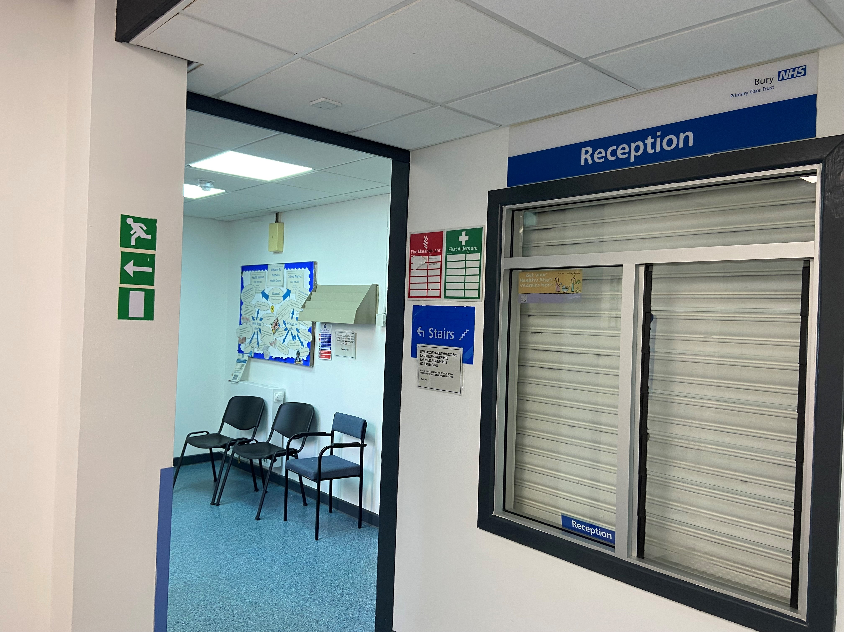
Prestwich Walk in Centre
(PWIC)
What is the address?
Prestwich Walk in Centre, Fairfax Road, Prestwich, M25 1BT
Where can I park?
There are two free car parks next to the clinic
What does the building look like and where do I wait?
Enter the building through the health centre and take your immediate right through the door. There’s a small waiting area with chairs to the left.

Slide 6
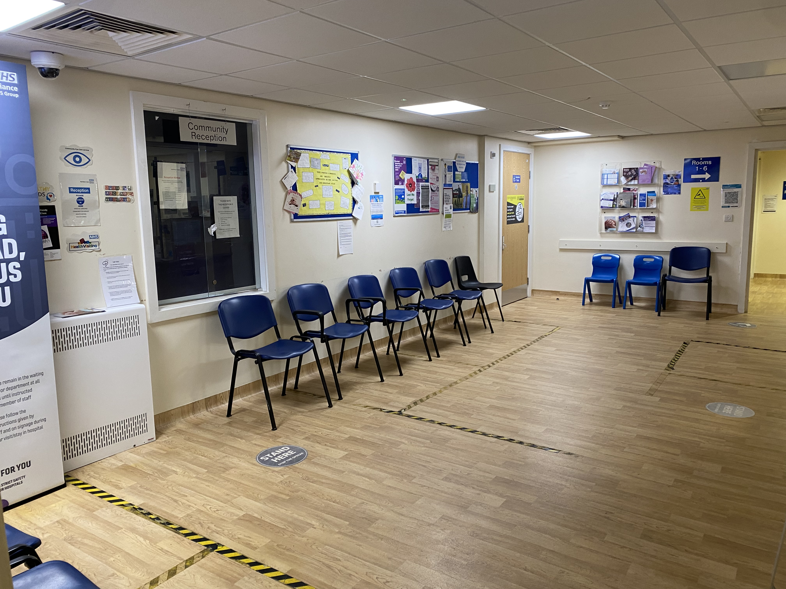
Ramsbottom Health Centre
(Rams HC)
What is the address?
Ramsbottom Health Centre, Carr Street, Ramsbottom, BL0 9DD
Where can I park?
There is a free car park on Carr Street next to Cohens Chemist
What does the building look like and where do I wait?

